Slide 1
Financial Complaints Dashboard | #RWFD
File created on: 12/28/2024 3:43:12 PM

Slide 2
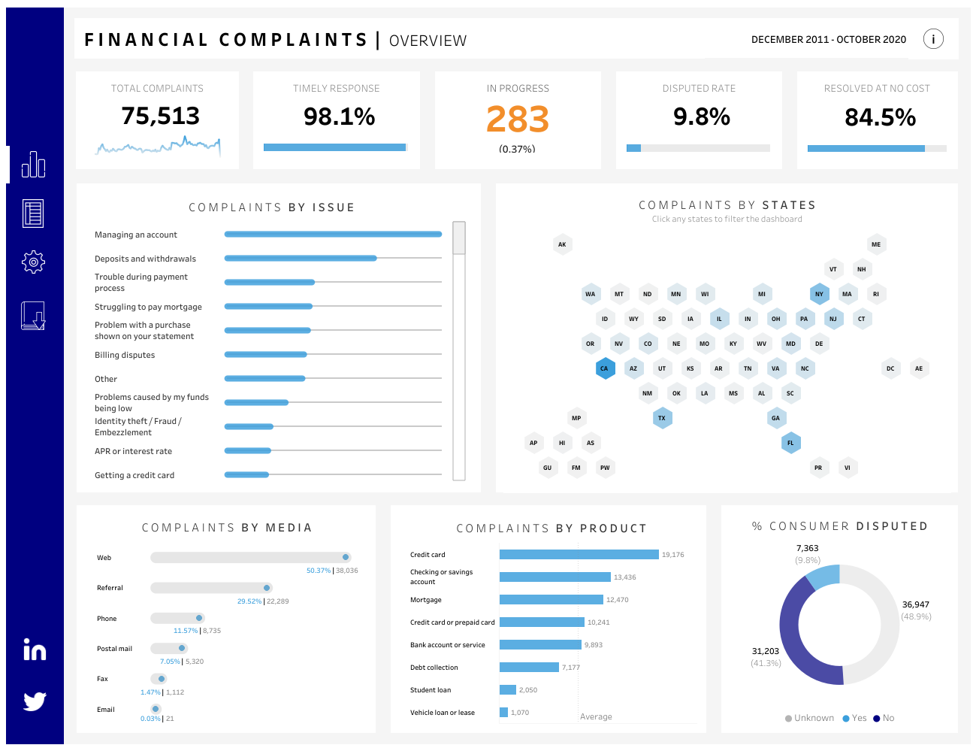

Slide 3
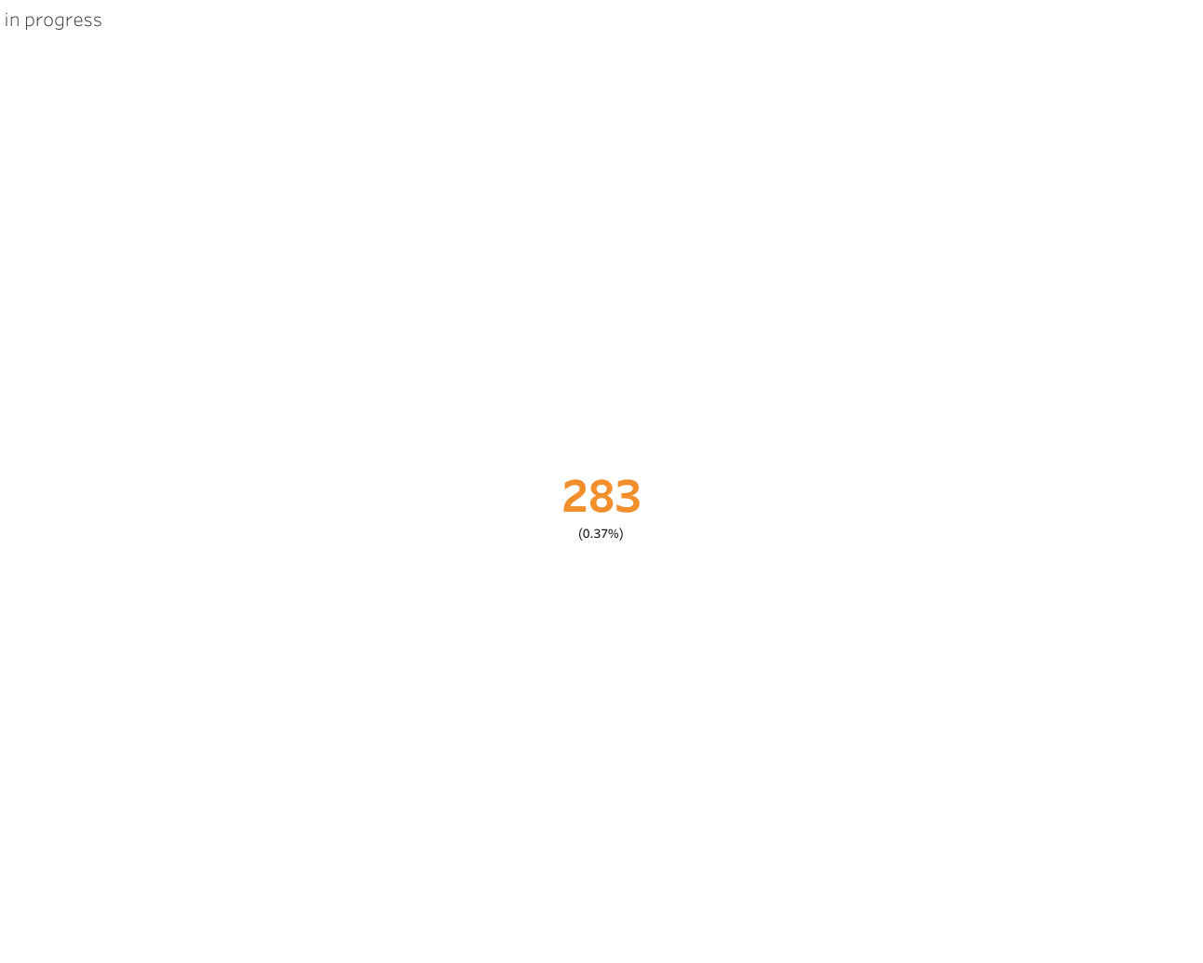

Slide 4
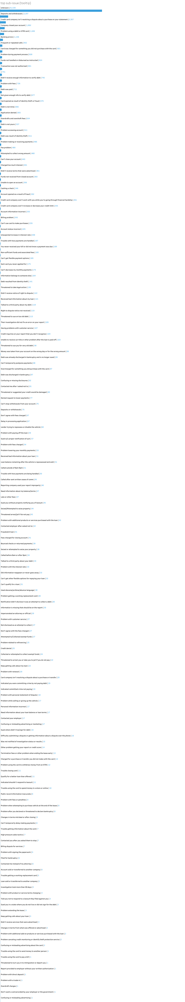

Slide 5
